Slide 1
G1 T3
SUPERVISOR MEETING II
brought to you by Blab-bers
Bid Like A Boss..

Slide 2
Agenda
Follow-ups
Current progress
Planned vs Actual
Task Allocation
Metrics
The Way Ahead

Slide 3
Follow-ups
Advices from Supervisor | Follow-up Actions Taken
Including buffer time for schedule | Done as requested
Deploy App on Openshift | Done as requested
Notes:
bug metric

Slide 4
Completed Functions (Iteration 2)
Bootstrapping
Bid for Session
Drop Session
Drop Bid
Update Bid
Login
Search Course
View All Bids

Slide 5
Completed Functions (Iteration 3)
JSON Responses
Admin Functions
Start Bidding Round
Stop Bidding Round
User Interface for Student side functions
Deployment

Slide 6

Issues
Wrong Design Concept for User Interface
Login page and the mainpage.jsp are combined into one (Not sustainable).

Slide 7
Schedule Progress
Planned Timeline
Iter #3 Start!
Coding
Deployment
Testing & Debugging #2
Supervisor meeting
05/10
07/10
10/10
11/10
Iter #3 Start!
Coding
Deployment
Testing & Debugging #2
05/10
07/10
10/10
11/10
Supervisor meeting
Actual Timeline

Slide 8
Schedule Progress
Shift to next Iteration
Update Bid (JSON)
Delete Bid (JSON)
Dump(bid, section)
Delete Bid
Drop Section
Require Validations
Changes in Validation functions
Require Round 1 Clearing Logic(Iter #4)

Slide 9
Task Alloction #3
Task | Pang Zi Qi | Kong Yu Ning | Kevin Onggo | Nyein Su Aye | Nicholas
JSON Responses(Bootstraping, Dump tables) | ü |  |  |  | ü
Start/Stop Bidding Rounds | ü |  |  | ü
UI (Login, Home, Bid Status) |  | ü | ü | ü
UI(Populate User Details, Deliver Course Search Results) | ü |  | ü | ü | ü
UI(Populate Timetable) |  | ü |  |  | ü
UI(Add/Edit/Drop Bids) |  |  | ü |  | ü
Deployment & Testing | ü | ü | ü | ü | ü
Debugging | ü | ü | ü | ü | ü
Quality Assurance | ü | ü | ü

Slide 10
Programming Hours #2 & #3

Slide 11
Current Metrics #3
 | Schedule | Bug | Pair Programming
Score | 1.0 | 24 | 1.045
Action | - | Stopped the development and fixed the bug immediately. | -

Slide 12
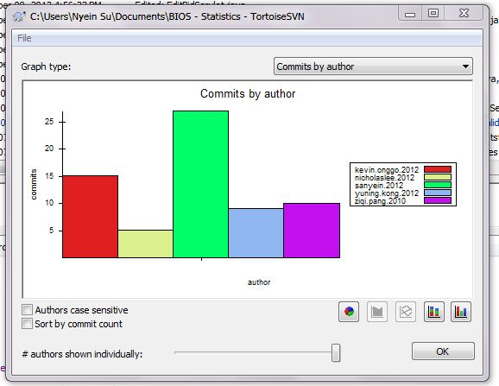
SVN

Slide 13
Goals for Next 2 Weeks
Iter #4 Start!
Round 1 Logic
Heuristics
Round 2 Logic & Post Improvements
11/10
14/10
19/10
22/10
23/10
UI Enhancement
2 Weeks (11/10 – 29/10)

Slide 14

G1 T3
Thank you! ☺
YUNING
KEVIN
NYEIN SU
NICHOLAS
ZACHERY

